Slide 1
Practical Mobile Development
[ speaker name]
[ speaker contact methods ]
Notes:
Put your details above.
Each slide contains example script in the notes. Once confident with the content, you can use the headings in the notes as cues to ad-lib the content in your own words.

Slide 2
Recap: A Better Model for Development
Windows
Android
iOS
One Language
One Toolset
Native API/Perf
Native UI/Perf
Single UI Framework
Notes:
Let’s go back to what we have seen achieved with the last two sessions
CLICK One Language/Toolset
We saw a toolset available on Windows and Mac using C# to build code that runs on many platforms
CLICK Native API/Perf
We saw code that has access to 100% of the platform APIs with great performance
CLICK Native UI/Perf
We got the ability to use native UI designers which use native controls
CLICK Single UI – Xamarin.Forms
We have the option of building one UI with XAML which turns into native controls on each platform

Slide 3
GPSImageTag
Android
UWP
iOS
Android
Shared code
Portable UI based on Xamarin.Forms
Portable View Models
Portable Models & Code Services
Notes:
With the GPSImageTag demo application we used those capabilities to start building an application with examples of both…
CLICK
… Native UI code on Android and …
CLICK
… Xamarin.Forms XAML to share UI between mobile platforms.
CLICK
It was built up from portable business models and services including code calling Azure client libraries obtained from Nuget packages…
CLICK…
… wrapped in a layer that exposes data and commands for binding by the UI as well as orchestrating calls to services.
CLICK
We also have shared code incorporated into all mobile platform heads in a Shared project using further NuGet packages that are dependent on the mobile platforms.

Slide 4
Resolving Complexities
User Controls
Custom Renderers
Native Code & Wrappers
DevOps
Notes:
In this session we’ll cover a few important practicalities to resolve some of the complexities of cross-platform mobile development
CLICK
In many applications there’s a need to re-use UI components in various parts of the UI. We’ll look at how we create user controls, sometimes called custom controls, by composing other controls together in XAML.
CLICK
Xamarin Forms presents a set of controls that are available on all platforms. You may find that either those controls do not render the same way on all platforms or that there’s a control available on some platforms but not all and you want to add that do Xamarin Forms XAML but need a way to compose it from native pieces on a platform that doesn’t include it natively. For example there’s no checkbox natively on iOS.
CLICK
Sometimes there’s native code in the form of Java code on Android that you need to include without converting to C#. We’ll see an example of that being done.
CLICK
We’ll also cover DevOps for mobile application development

Slide 5
Demo
‘User control’
Notes:
So let’s look at how to compose existing Xamarin Forms XAML controls into a new control

Slide 6
Demo
Custom renderer
Notes:
Now let’s deal with the steps to get a control to be consistent across all UI platforms

Slide 7
Demo
Wrapper
Notes:
And now, let’s wrap some Java code for use in our Xamarin application

Slide 8
Sprinkling on some DevOps
Windows
Android
iOS
One Language
One Toolset
Native API/Perf
Native UI/Perf
Single UI Framework
Source control
Build system
Testing
Monitoring
Notes:
So we’ve dealt with some practicalities in using Xamarin and Xamarin Forms. Now let’s look at DevOps.
CLICK
Getting our code into source control should be a top priority, even for a one-man shop.
CLICK
Having a build system with continuous integration takes away some of the manual burden and offers the opportunity for automated unit tests to run.
CLICK
Being able to run additional tests such as UI tests against different devices can help avoid issues difficult to diagnose in the wild, and automatically deploying our application to test users starts to create a valuable network of feedback
CLICK
Having access to crash reports, user feedback and details of how an application is used, helps us response to issues quickly and gain valuable insights that can help guide future development of a product

Slide 9
Demo
Mobile DevOps
Notes:
Let’s see DevOps applied to our sample application.

Slide 10
Demo
GPS & Map
Notes:
It’s implied in the sample application’s name. Let’s add a common feature - getting user location - into our GPS image-tagging application using an available plug-in. We’ll then add in a map to show the photo locations and use a custom render to get a consistent pin popup feature on all platforms.

Slide 11
Demo
DevOps Results
Notes:
Let’s return to DevOps to see the results of our build, cloud UI testing as well as application release and usage.

Slide 12
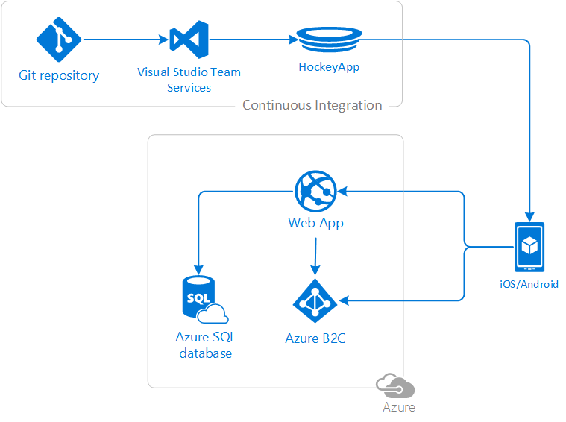
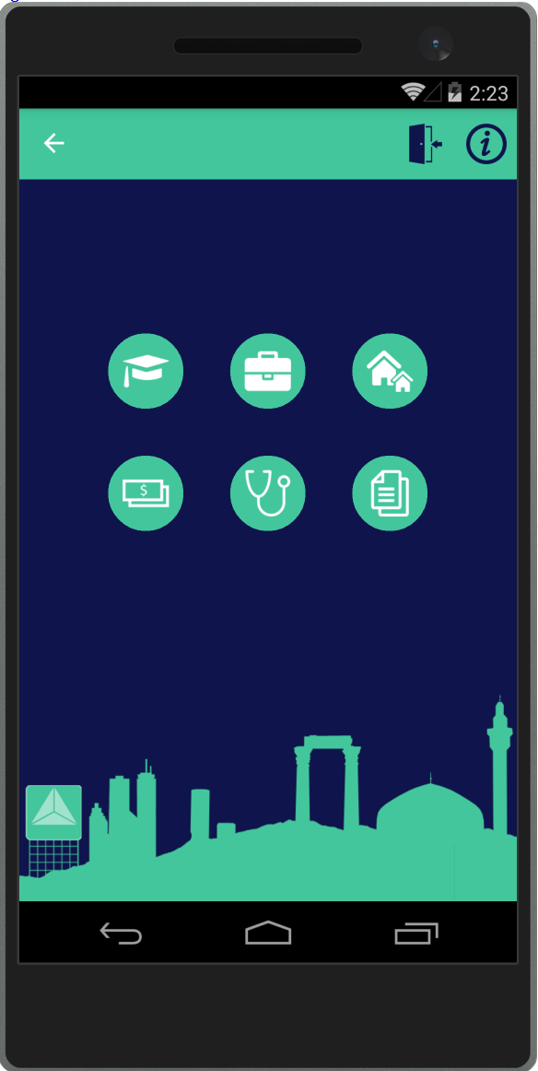
DevOps: Urban Refuge in Amman, Jordan
Serving 78% of 655,000 registered Syrian refugees in Jordan
Xamarin Forms app for Android & iOS with ASP.NET Core API and mgmt. portal
VSTS repo with auto deployment
HockeyApp for tester feedback and tracking what users really need to help them
Notes:
Urban refugees make up 78% of the 655,000 registered Syrian refugees in Jordan.
CLICK
The app Urban Refuge solves the problem of access to aid and circumvents social stigma facing urban refugees, providing information on assistance opportunities, with the listings made available in English and Arabic.
CLICK
It’s a Xamarin Forms cross-platform mobile application for Android and iOS that communicates with an ASP.NET Core API and management portal hosted in the Web Apps feature of Azure App Service.
CLICK
Using the DevOps practice of Automated Deployment, the Urban Refuge team uses Visual Studio Team Services (VSTS) to deploy to their beta testers on demand via the HockeyApp integration. The testers can then submit bug reports directly back to the Urban Refuge team, shortening the feedback cycle.
CLICK
The Urban Refuge team also gets to monitoring the filters users pick to find assistance which helps them focus the available resources that get listed.

Slide 13
HOL 1
GPSImageTag – Cloud Photos
Notes:
Now you can try some Xamarin development yourselves with the GPSImageTag application. You’ll start with code that lets you take a photo and add in the pieces necessary to upload a photo to the cloud and sync down the list of previously updated photos. You can try this on Windows 10, or in the Android emulator if you have a Hyper-V enabled PC with the Android emulator ready.

Slide 14
Resources
Learn about Xamarin - https://www.xamarin.com/platform
Get started for free on Mac & PC - https://store.xamarin.com/
The Xamarin Show - https://channel9.msdn.com/Shows/XamarinShow
Xamarin University - https://www.xamarin.com/university
Notes:
As shown

